Slide 1
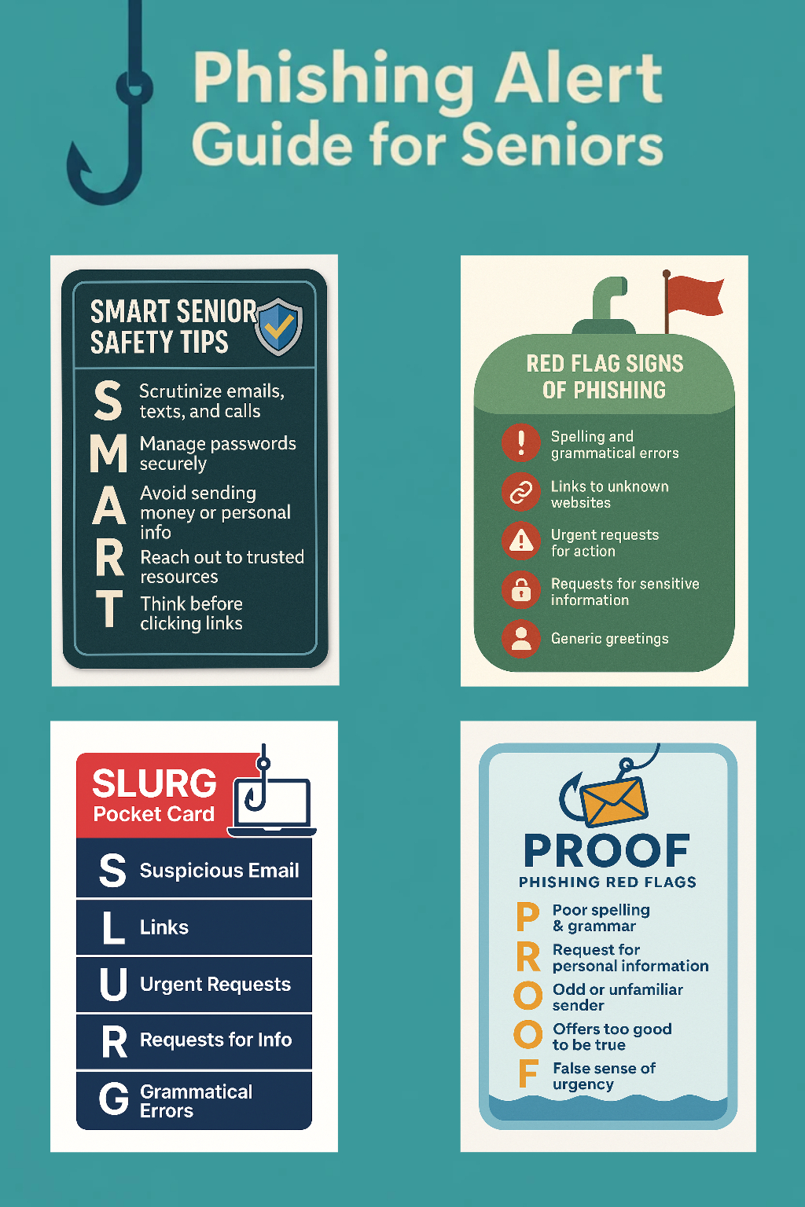

Phishing Alert: A Guide for Seniors A quick lesson on how to spot phishing scams, protect your information, and stay safe online. By Luke Horner and James Jordon Hocking College Cybersecurity Program

Slide 2

About us
At Hocking College Cybersecurity Program, we teach people of all walks of life how to protect information online through involvement and collaborative efforts to drive cybersecurity education to the community as a whole. By freely providing this information to everyone, we help ensure those individuals have the tools necessary to protect their personal information to a more effective extent offline and online.

Slide 3


What Is Phishing?
Phishing is defined as using tricks to make people give up personal information or money through nefarious and illegal means.
Common phishing channels scammers use include fake emails, texts, and even phone calls spoofing loved ones’ voices.
Make absolute sure you know who you are speaking with or writing to before divulging any personal information.

Slide 4

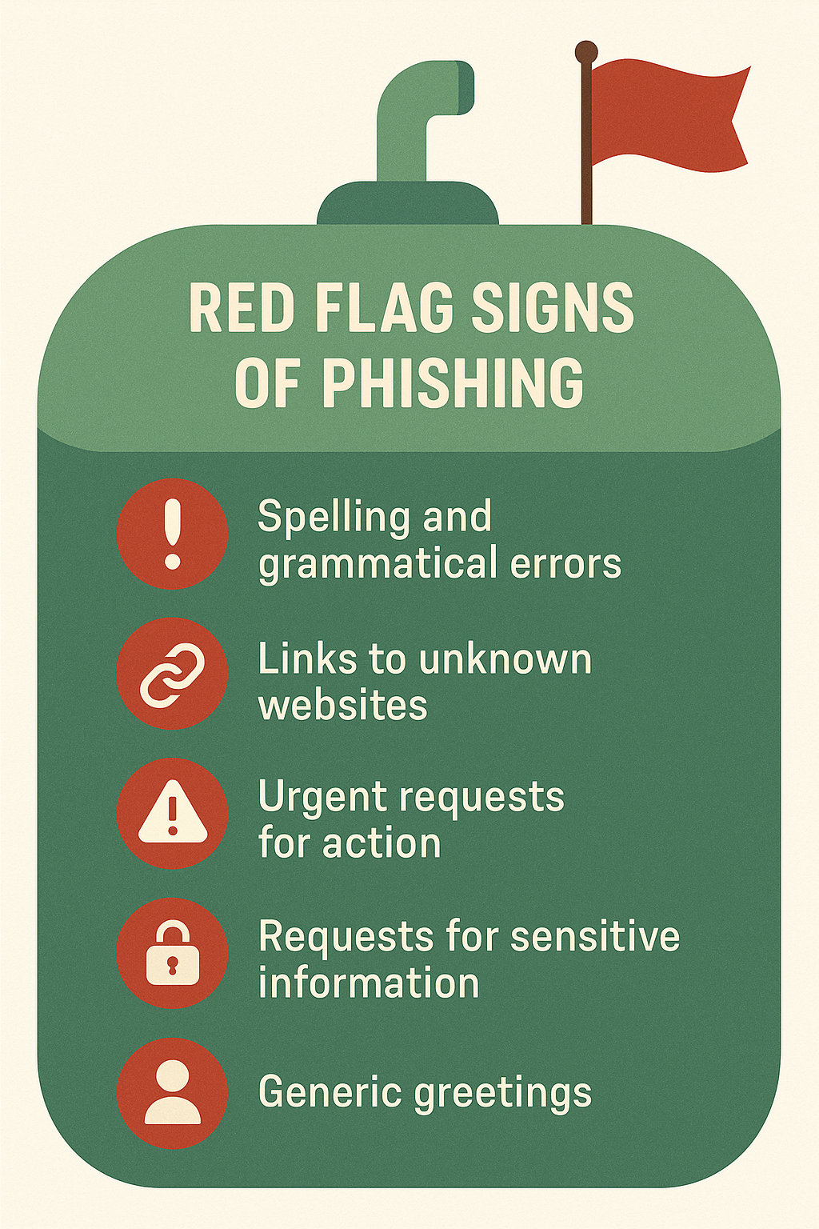
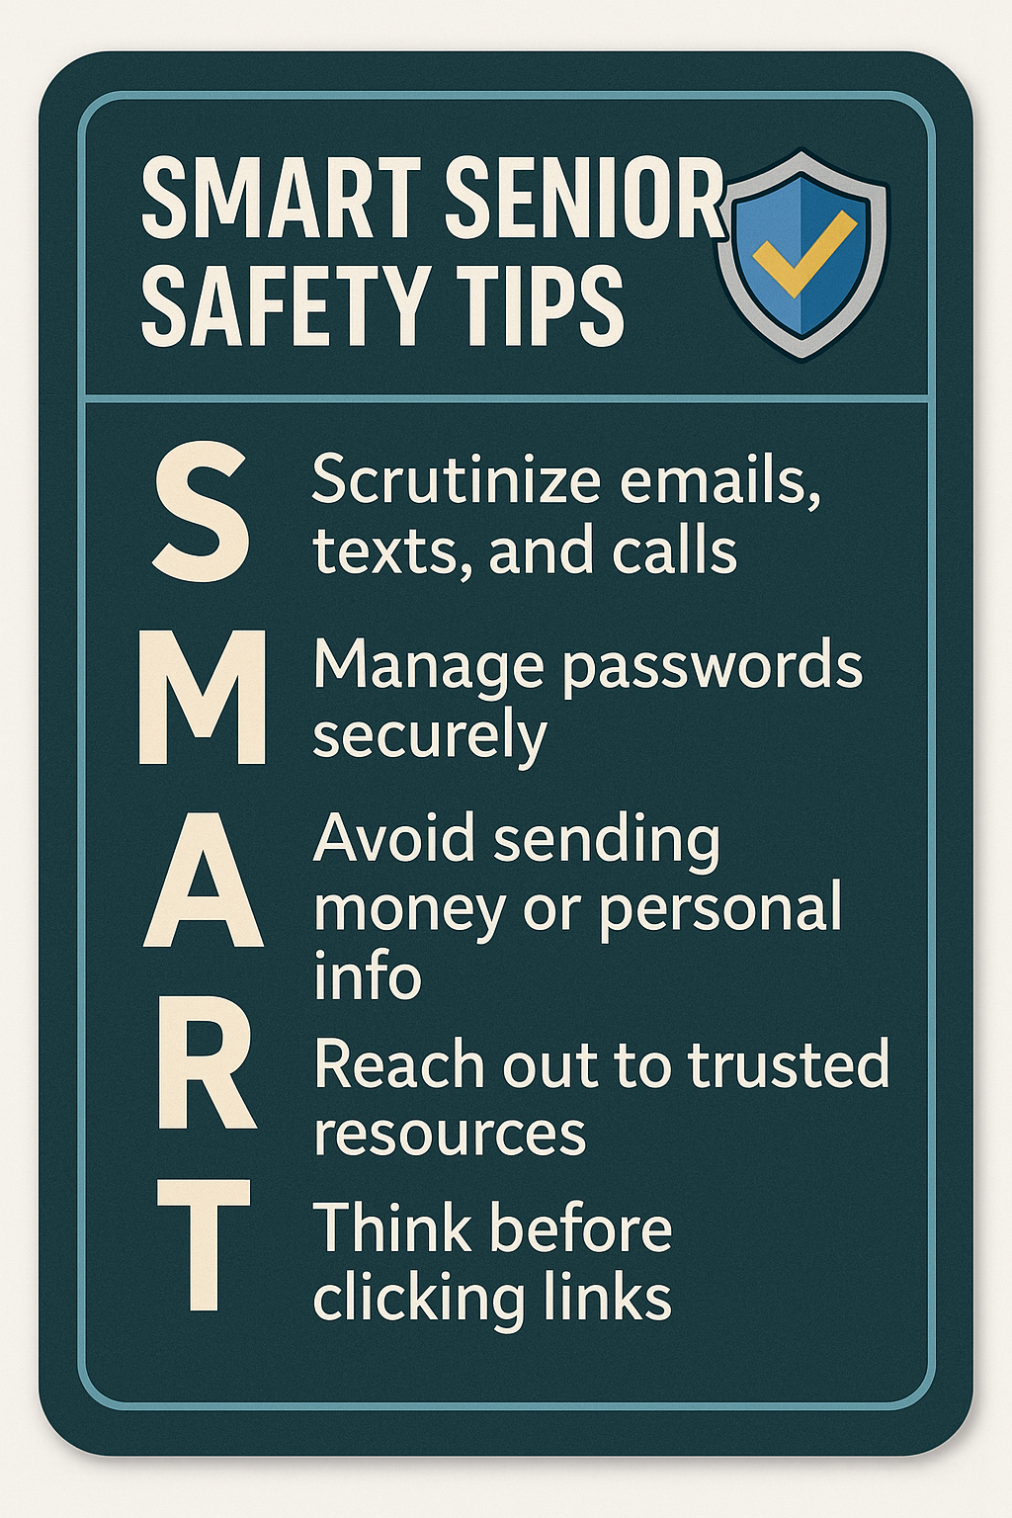
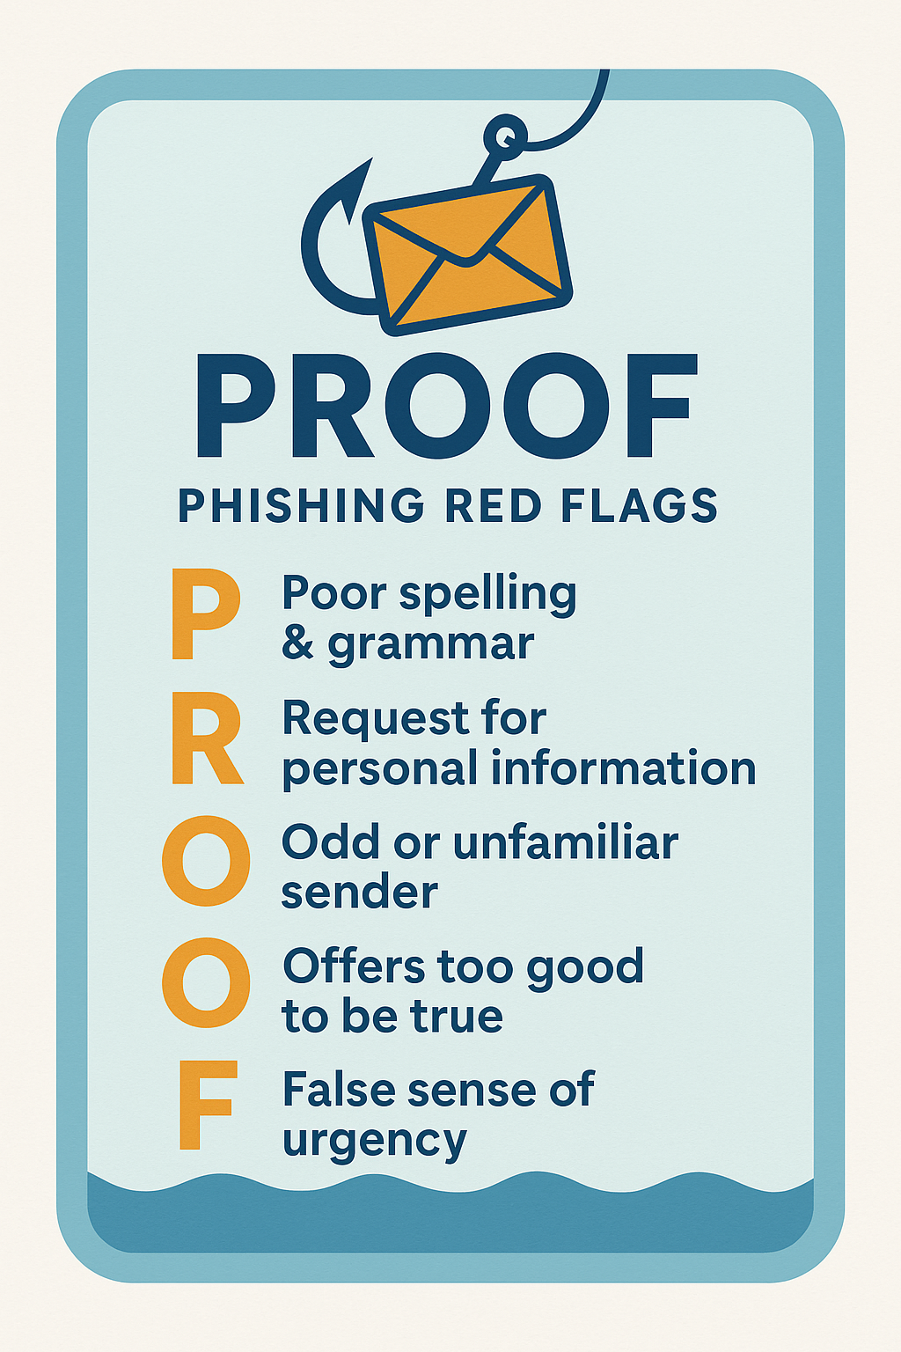
Why detecting and understanding phishing scams are vital: In 2024 alone, $5+ Billion were stolen from Boomers online through various scams (Aydin, 2025). Don’t be the next statistic! Use SMART Senior Safety Tips and PROOF Red Flags of Phishing to stay safe.

Slide 5

PROOF: Watch for Phishing Red Flags
Poor spelling and grammar: Many scammers will misspell words, names, or phrases with multiple grammatical and punctuation errors typical companies would not make.
Request for personal information: The scammers will invent a reason to ask you for personal information or money. DON’T DIVULGE ANYTHING!
Odd or unfamiliar sender or caller: Scammers will come from all angles trying to gain access to your information. Watch for new, odd, or unacquainted senders.
Offers too good to be true: loss of productivity costing consumers thousands of dollars
False sense of Urgency: customers want something easy to use that helps make their life easier

Slide 6
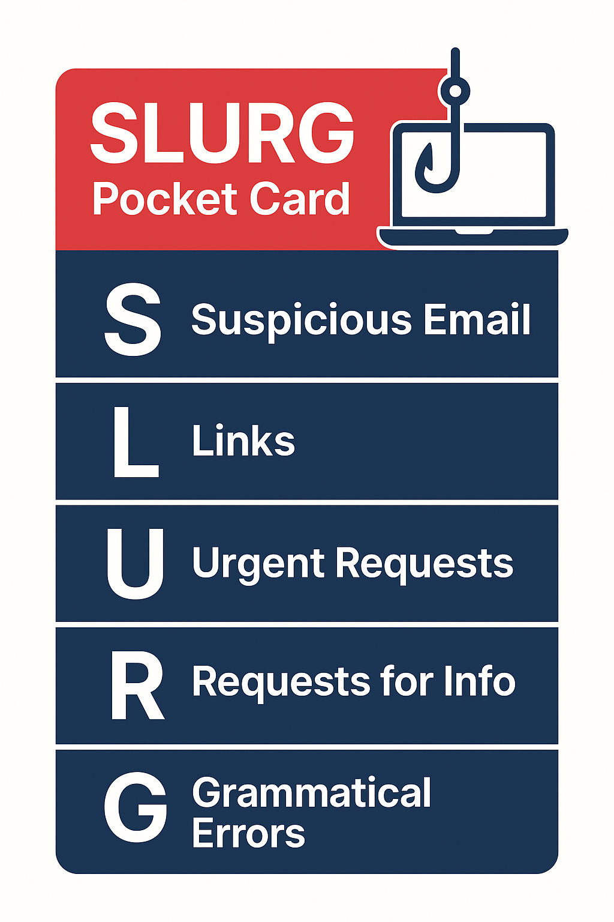
Acronyms to remember:

Slide 7
First Phishing Example
Obvious Bank Scam Email
From: support@secure-bank-alerts.com Reply-To: alerts@secure-bank-alerts.com To: j.senior@example.com Subject: Important: Your Bank of Sorrow Account Has Been Locked — Verify Now
Body (plain text):
Dear Customer,
We detected suspicious activity on your Bank of Sorrow account and have temporarily locked access to protect you. To restore full access and avoid permanent suspension, please verify your account immediately.
Verify Now: https://bankofsorrow-login.com/verify
If we do not receive verification within 24 hours your account will be closed.
Thank you for your prompt attention. Bank of Sorrow Security Team

Slide 8
First Phishing Example
Obvious Bank Scam Email
From: support@secure-bank-alerts.com Reply-To: alerts@secure-bank-alerts.com To: j.senior@example.com Subject: Important: Your Bank of Sorrow Account Has Been Locked — Verify Now
Body (plain text):
Dear Customer,
We detected suspicious activity on your Bank of Sorrow account and have temporarily locked access to protect you. To restore full access and avoid permanent suspension, please verify your account immediately.
Verify Now: https://bankofsorrow-login.com/verify
If we do not receive verification within 24 hours your account will be closed.
Thank you for your prompt attention. Bank of Sorrow Security Team
Visible link text (what it looks like in the email): https://www.bankofsorrow.com
Actual underlying URL (hover target): https://bankofsorrow-login.com/verify
Red flags:
Generic greeting (“Dear Customer”) instead of your name.
Urgent deadline (24 hours → pressure).
Link text doesn’t match actual URL (hover mismatch).
Sender domain is not the real bank domain (secure-bank-alerts.com ≠ bankofsorrow.com).
Threatening tone (account will be closed) — common phishing tactic.

Slide 9

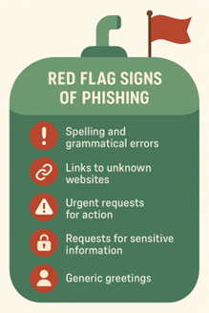
Red Flags of Phishing
Make sure to scrutinize all texts, emails, and calls for these red flags such as generic greetings, spelling and grammar errors.
Make sure to HOVER your cursor over a link to check if the text from the link is the same address as where the link takes you. This is called Hover-to-reveal.
Scammers will use every type of social engineering to gain access such as urgent requests, such as time frames, governmental agencies, or even fake family emergencies. Check every source and do not blindly trust anyone on the internet.
Your best bet is to always REPORT and DELETE said emails!
Some are tricky like this next example…

Slide 10
Second Phishing Example
Tricky “Medicare” Update (targeted & believable)
From: medicare-update@my-govsupport.net Reply-To: medicare-update@my-govsupport.net To: j.senior@example.com Subject: Action Required: Medecare Enrollment Verification
Body (HTML-style with formatting):
IMPORTANT: Your Medicare enrollment needs verification before Oct 5. Click the secure link below to confirm your details and ensure coverage continues. Failure to confirm may disrupt your benefits.
Confirm Now: <a href="http://confirm-medicare.help/verify">https://medicare.gov/verify</a>
If you have any questions, contact our Medicare Support Center.
Visible link text: https://medicare.gov/verify Actual underlying URL (hover target): http://confirm-medicare.help/verify

Slide 11
Second Phishing Example
Tricky “Medicare” Update (targeted & believable)
From: medicare-update@my-govsupport.net Reply-To: medicare-update@my-govsupport.net To: j.senior@example.com Subject: Action Required: Medicare Enrollment Verification
Body (HTML-style with formatting):
IMPORTANT: Your Medecare enrollment needs verification before Oct 5. Click the secure link below to confirm your details and ensure coverage continues. Failure to confirm may disrupt your benefits.
Confirm Now: <a href="http://confirm-medicare.help/verify">https://medicare.gov/verify</a>
If you have any questions, contact our Medicare Support Center.
Visible link text: https://medicare.gov/verify Actual underlying URL (hover target): http://confirm-medicare.help/verify
Annotations / Red flags:
1. Sender domain (my-govsupport.net) is not an official government domain.
2. Link text shows medicare.gov but Hover-To-Reveal (HREF) is different.
3. Slight misspelling or odd punctuation sometimes present in body (watch for small errors).
4. Appeals to fear of losing benefits- emotional trigger based on an urgent deadline.
5. Uses HTTP rather than HTTPS in the HREF (note: some phishing hosts do use HTTPS; hover + domain check still required).

Slide 12
Third Phishing Example
Family/Fake Payment Request (social engineering)
From: lisa.johnson@friends-mail.com Reply-To: lisa.johnson@friends-mail.com To: j.senior@example.com Subject: Can you help me? Emergency — Need $1,200
Body:
Hi Grandpa/Grandma,
I’m in a bit of trouble — my car broke down and I need $1,200 urgently to get home. Please send to: Venmo: @lisa-j-1984 or click this link to pay now: https://venmo.com/pay/lisa_johnson
I’ll pay you back as soon as I can. Please don’t tell Mom. — Lisa

Slide 13
Third Phishing Example
Family/Fake Payment Request (social engineering)
From: lisa.johnson@friends-mail.com Reply-To: lisa.johnson@friends-mail.com To: j.senior@example.com Subject: Can you help me? Emergency — Need $1,200
Body:
Hi Grandpa/Grandma,
I’m in a bit of trouble — my car broke down and I need $1,200 urgently to get home. Please send to: Venmo: @lisa-j-1984 or click this link to pay now: https://venmo.com/pay/lisa_johnson
I’ll pay you back as soon as I can. Please don’t tell Mom. — Lisa
Annotations / Red flags:
1.Emotional request & secrecy (“don’t tell Mom”) — typical scam tactic to avoid verification.
2.Unexpected money request from a contact that may be spoofed.
3. Ask to use instant-pay app — prefer in-person/phone verification.
4. Check the sender email carefully — is it a known address? If unsure, call the person on a known number.

Slide 14
Q&A: Phishing or Safe? You Decide…
Example 1
Example 2
From: no-reply@medicare.gov To: j.senior@example.com Subject: Medicare: Confirmation of Enrollment Update
Body:
Dear Jordon,
We received your enrollment update request and have processed it successfully. No further action is needed at this time. If you did not request this change or have questions, please visit our official website by typing medicare.gov into your browser or call the Medicare helpline at 1-800-633-4227.
Thank you, Medicare Enrollment Services
Visible link text (if included): https://medicare.gov Underlying URL / hover target (show in a small caption for teaching): https://medicare.gov
From: medicare-update@my-govsupport.test Reply-To: medicare-update@my-govsupport.test To: j.senior@example.com Subject: Action Required: Confirm Your Medicare Enrollment by Oct 5
Body :
IMPORTANT: Your Medicare enrollment needs verification to avoid interruption of benefits. Click the secure link below and confirm your personal information now to prevent coverage disruption.
Confirm now: https://medicare.gov/verify
If you do not confirm within 48 hours your benefits may be suspended.
— Medicare Support Team
Visible link text (what the reader sees): https://medicare.gov/verify Actual underlying URL (hover target — use this in your annotation box): http://confirm-medicare.help.test/verify

Slide 15
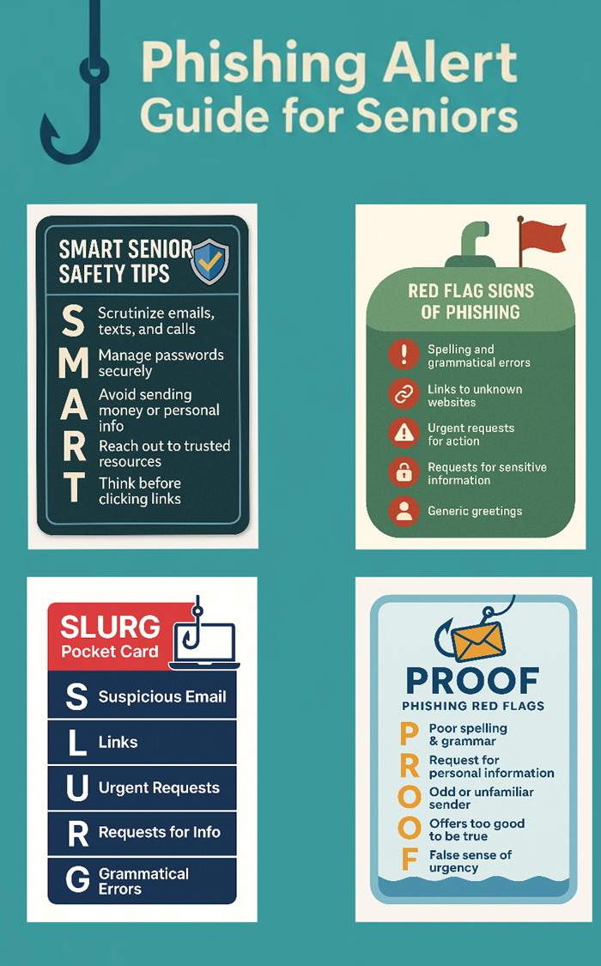

Recap & Resources
Main takeaways: Pause, Inspect, Verify, Report.
Take your time and do not fall for their fake urgency.
Inspect any hyperlinks to make sure the addressed match via the Hover-to-reveal box.
Verify with other corroborating sources such as calling your loved one directly for confirmation before giving ANY personal information or money away.
If the phishing email, text, or call is fishy, always be sure to Report and Delete it as soon as possible!

Slide 16
Thank you
Luke Horner and James Jordon
hornerl@hocking.edu
jordonj@hocking.edu
Cybersecurity and Network Systems

Slide 17
References
Aydin, Y. (2025, June 14). Boomers are getting scammed for billions online — how to break the cycle. Boomers are getting scammed for billions online — here’s how to break the cycle. https://thehill.com/opinion/finance/5349012-financial-losses-elderly-scamming/
Ben. (2025, March 17). Which demographics are targeted most by cybercriminals? Key Insights & Trends. cybercrimereport.org. https://cybercrimereport.org/demographics-targeted-by-cybercriminals/
Coacci, J. (2025, September 4). Boomers’ wealth soars, leaving millennials and gen Z behind. Fortune. https://fortune.com/2025/09/03/baby-boomer-wealth-gap-millennials-gen-x-z-investing-home-prices/
*AI Use Note (if used): SAGE (ChatGPT) was used to help organize information into viable slides as well as help create phishing email examples utilized.

